Slide 1
Modelling Colombian Economy: Stock-Flow Consistent Prototype Growth Model
An adaptation from Yilmaz & Godin (2020).

Slide 2
Households.
We introduced a desired demand of credit that depends on desired consumption, interest rate, and the average repayment ratio. This formulation is an adaptation from Van Treeck (2009) and Dafermos (2012).
Since in developing economies credit rationing is an important feature in credit markets, we introduced a logistic equation based on Caiani et al. (2016) in order to capture this dynamic. In consequence, the credit supply is a share of the desired credit demand that changes according to borrowers’ risk and liquidity conditions.
Interest rate on households’ loans is a constant mark – up over the interest rate faced by the firms.

Slide 3
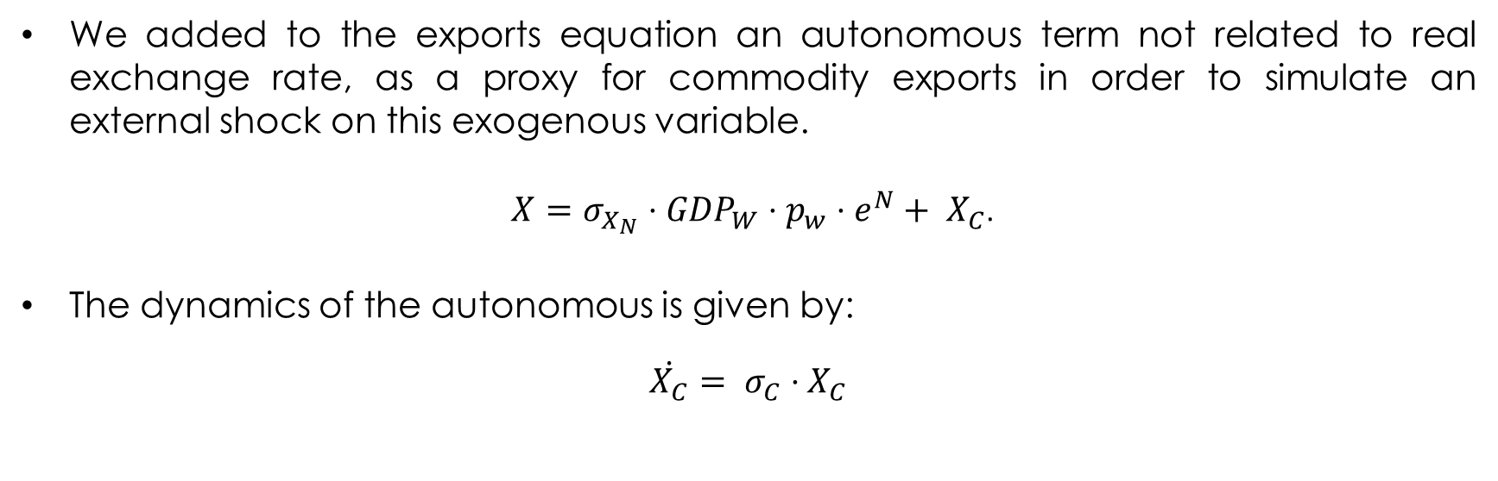
Exports.
We added to the exports equation an autonomous term not related to real exchange rate, as a proxy for commodity exports in order to simulate an external shock on this exogenous variable.
$X=σ_{X_{N}}⋅{GDP}_{W}⋅p_{w}⋅e^{N}+ X_{C}$.
The dynamics of the autonomous is given by:
$\dot{X_{C}}= σ_{C}⋅X_{C}$

Slide 4
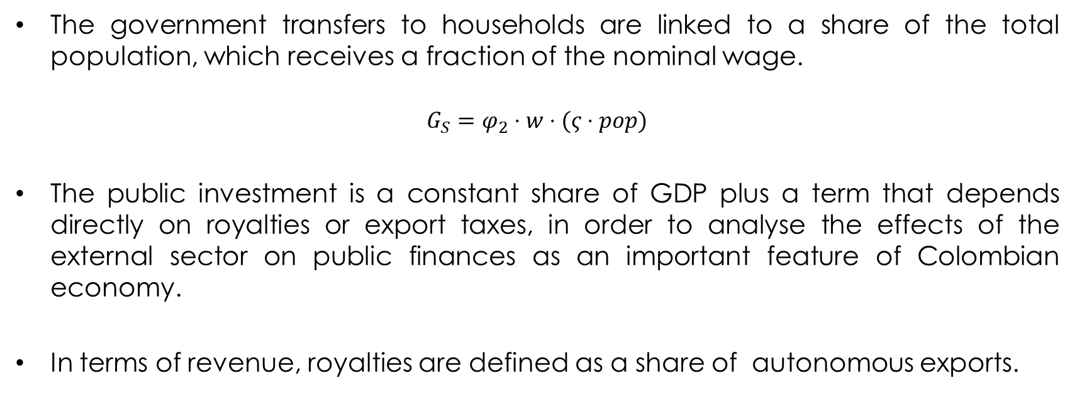
Government.
The government transfers to households are linked to a share of the total population, which receives a fraction of the nominal wage.
$$G_{S}=φ_{2}⋅w⋅(ς⋅pop)$$
The public investment is a constant share of GDP plus a term that depends directly on royalties or export taxes, in order to analyse the effects of the external sector on public finances as an important feature of Colombian economy.
In terms of revenue, royalties are defined as a share of autonomous exports.

Slide 5
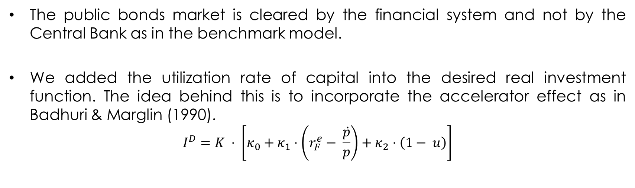
Bonds Market & Investment.
The public bonds market is cleared by the financial system and not by the Central Bank as in the benchmark model.
We added the utilization rate of capital into the desired real investment function. The idea behind this is to incorporate the accelerator effect as in Badhuri & Marglin (1990).
$$I^{D}=K ⋅ \left[κ_{0}+κ_{1}⋅\left(r_{F}^{e}− \frac{\dot{p}}{p}\right)+κ_{2}⋅\left(1− u\right)\right]$$

Slide 6
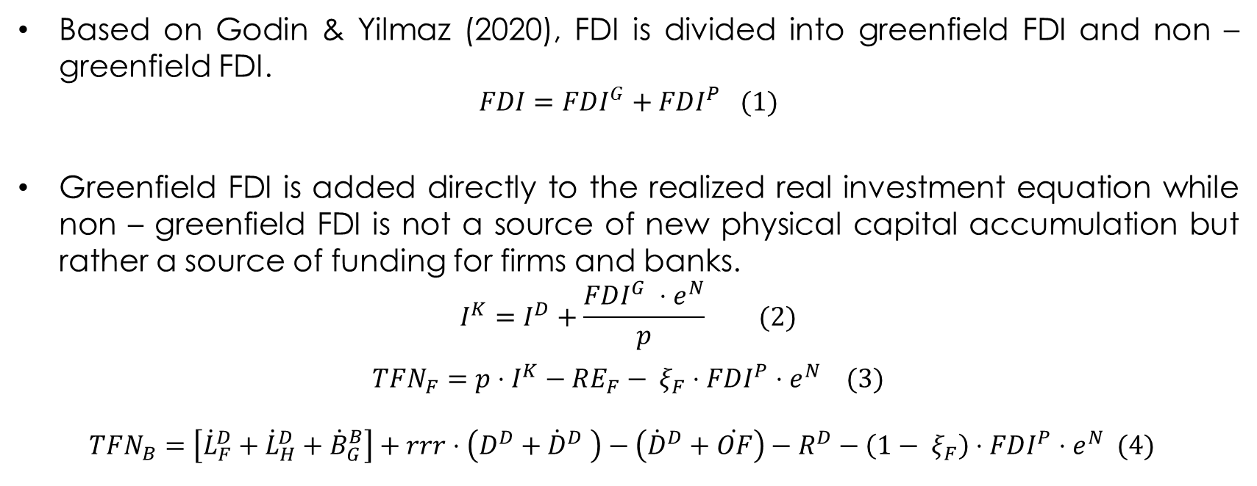
Foreign Direct Investment.
Based on Godin & Yilmaz (2020), FDI is divided into greenfield FDI and non – greenfield FDI.
$$FDI=FDI^{G}+FDI^{P} (1)$$
Greenfield FDI is added directly to the realized real investment equation while non – greenfield FDI is not a source of new physical capital accumulation but rather a source of funding for firms and banks.
$$I^{K}=I^{D}+\frac{FDI^{G} ⋅e^{N}}{p} (2)$$
$$TFN_{F}=p⋅I^{K}−RE_{F}− ξ_{F}⋅FDI^{P}⋅e^{N} (3)$$
$$TFN_{B}=\left[{\dot{L}}_{F}^{D}+{\dot{L}}_{H}^{D}+{\dot{B}}_{G}^{B}\right]+rrr⋅\left(D^{D}+{\dot{D}}^{D} \right)−\left({\dot{D}}^{D}+\dot{OF}\right)−R^{D}−\left({1− ξ}_{F}\right)⋅FDI^{P}⋅e^{N} (4)$$

Slide 7
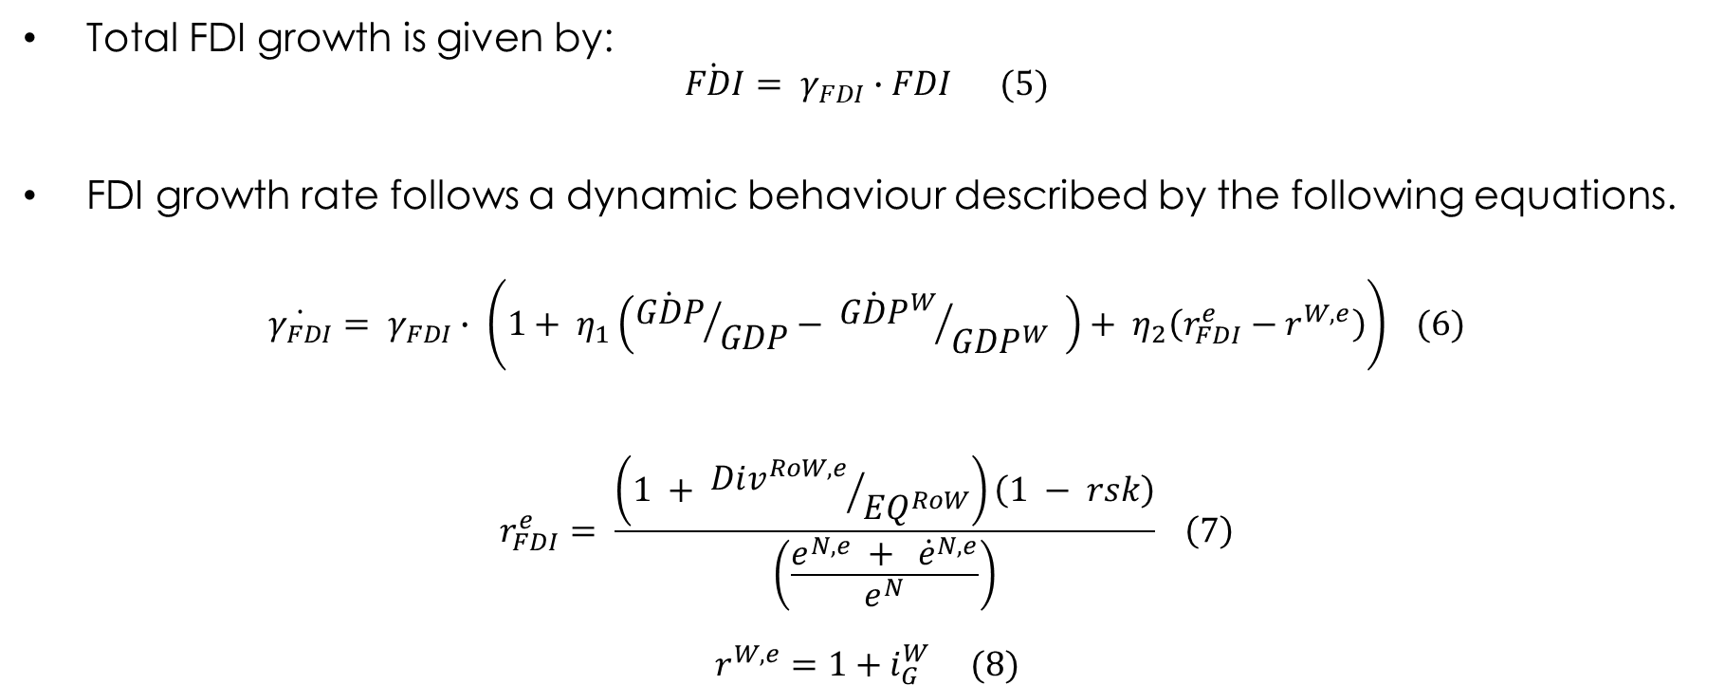
Foreign Direct Investment.
Total FDI growth is given by:
$$\dot{FDI}= γ_{FDI}∙FDI (5)$$
FDI growth rate follows a dynamic behaviour described by the following equations.
$$\dot{γ_{FDI}}= γ_{FDI}∙ \left(1+ η_{1}\left({\dot{GDP}}/{GDP}− {{\dot{GDP}}^{W}}/{GDP^{W}} \right)+ η_{2}\left(r_{FDI}^{e}−r^{W,e}\right)\right) (6)$$
$$r_{FDI}^{e}= \frac{\left(1 + {Div^{RoW,e}}/{EQ^{RoW}}\right)\left(1 − rsk\right)}{\left(\frac{e^{N,e} + {\dot{e}}^{N,e}}{e^{N}}\right)} \left(7\right)$$
$$r^{W,e}=1+i_{G}^{W} (8)$$

Slide 8
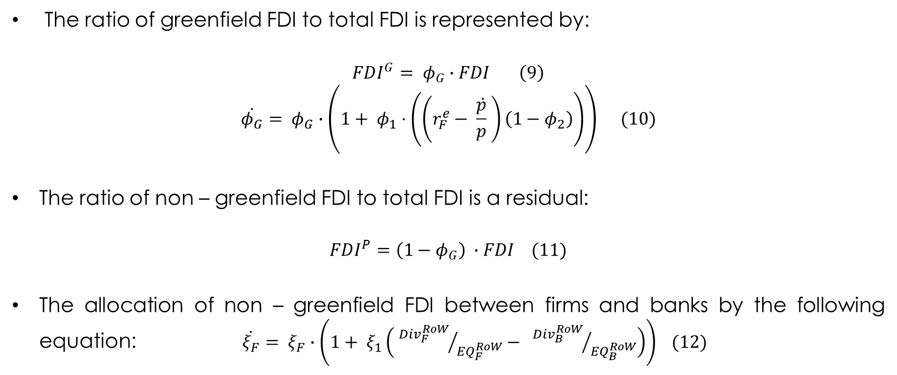
Foreign Direct Investment.
The ratio of greenfield FDI to total FDI is represented by:
$$FDI^{G}= φ_{G}∙FDI \left(9\right)$$
$$\dot{φ_{G}}= φ_{G}∙\left(1+ φ_{1}⋅\left(\left(r_{F}^{e}− \frac{\dot{p}}{p} \right)\left(1−φ_{2}\right)\right)\right) (10)$$
The ratio of non – greenfield FDI to total FDI is a residual:
$$FDI^{P}=\left(1−φ_{G}\right) ∙FDI (11)$$
The allocation of non – greenfield FDI between firms and banks by the following equation: $\dot{ξ_{F}}= ξ_{F}∙\left(1+ ξ_{1}\left( {Div_{F}^{RoW}}/{EQ_{F}^{RoW}}− {Div_{B}^{RoW}}/{EQ_{B}^{RoW}}\right)\right) (12)$

Slide 9
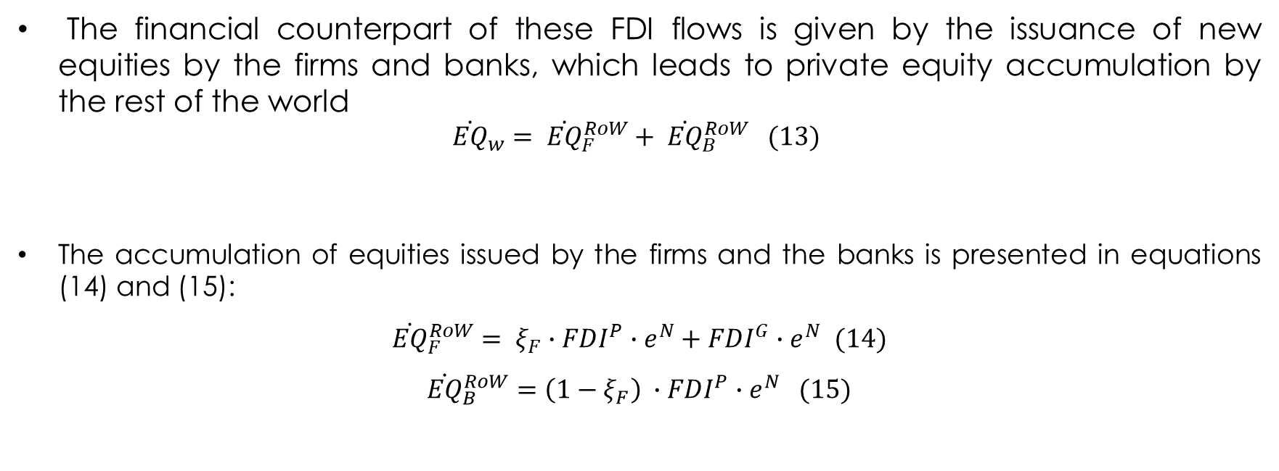
Foreign Direct Investment.
The financial counterpart of these FDI flows is given by the issuance of new equities by the firms and banks, which leads to private equity accumulation by the rest of the world
$${\dot{EQ}}_{w}= {\dot{EQ}}_{F}^{RoW}+ {\dot{EQ}}_{B}^{RoW} (13)$$
The accumulation of equities issued by the firms and the banks is presented in equations (14) and (15):
${\dot{EQ}}_{F}^{RoW}= ξ_{F}∙FDI^{P}∙e^{N}+FDI^{G}∙e^{N} (14)$
$${\dot{EQ}}_{B}^{RoW}=\left(1−ξ_{F}\right) ∙FDI^{P}∙e^{N} (15)$$

Slide 10

Foreign Direct Investment.
The dividends paid to the rest of the world are distributed considering the ownership structure of firms and banks
$$Div_{F}^{RoW}=\left(\frac{EQ_{F}^{RoW}}{EQ_{F}}\right)∙\left(Div_{F}\right) \left(16\right)$$
$$Div_{B}^{RoW}=\left(\frac{EQ_{B}^{RoW}}{EQ_{B}}\right)∙\left(Div_{B}\right) (17)$$

Slide 11
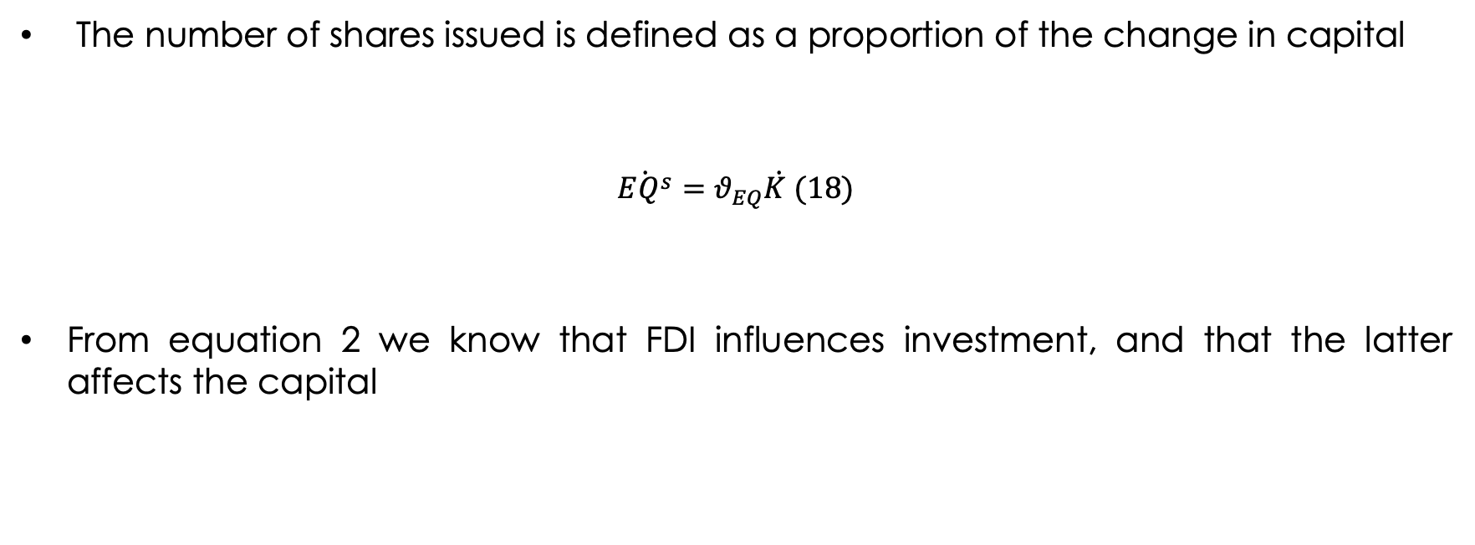
Equities and ownership structure
The number of shares issued is defined as a proportion of the change in capital
$$\dot{EQ^{s}}=θ_{EQ}\dot{K }(18)$$
From equation 2 we know that FDI influences investment, and that the latter affects the capital

Slide 12
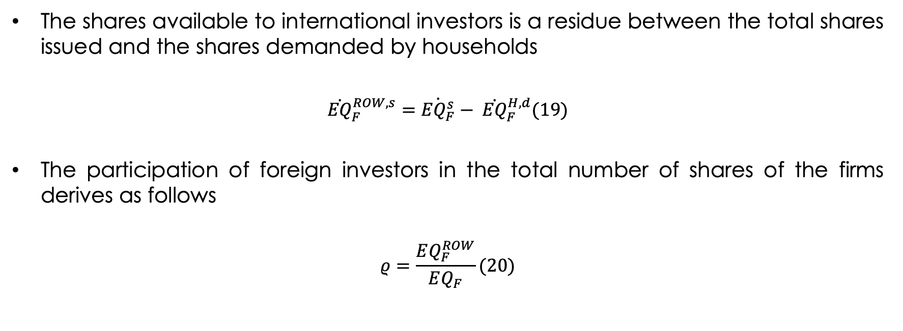
Equities and ownership structure
The shares available to international investors is a residue between the total shares issued and the shares demanded by households
$${\dot{EQ}}_{F}^{ROW, s}=\dot{{EQ}_{F}^{s}}− {\dot{EQ}}_{F}^{H,d}(19)$$
The participation of foreign investors in the total number of shares of the firms derives as follows
$$ρ=\frac{EQ_{F}^{ROW}}{EQ_{F}}(20)$$

Slide 13
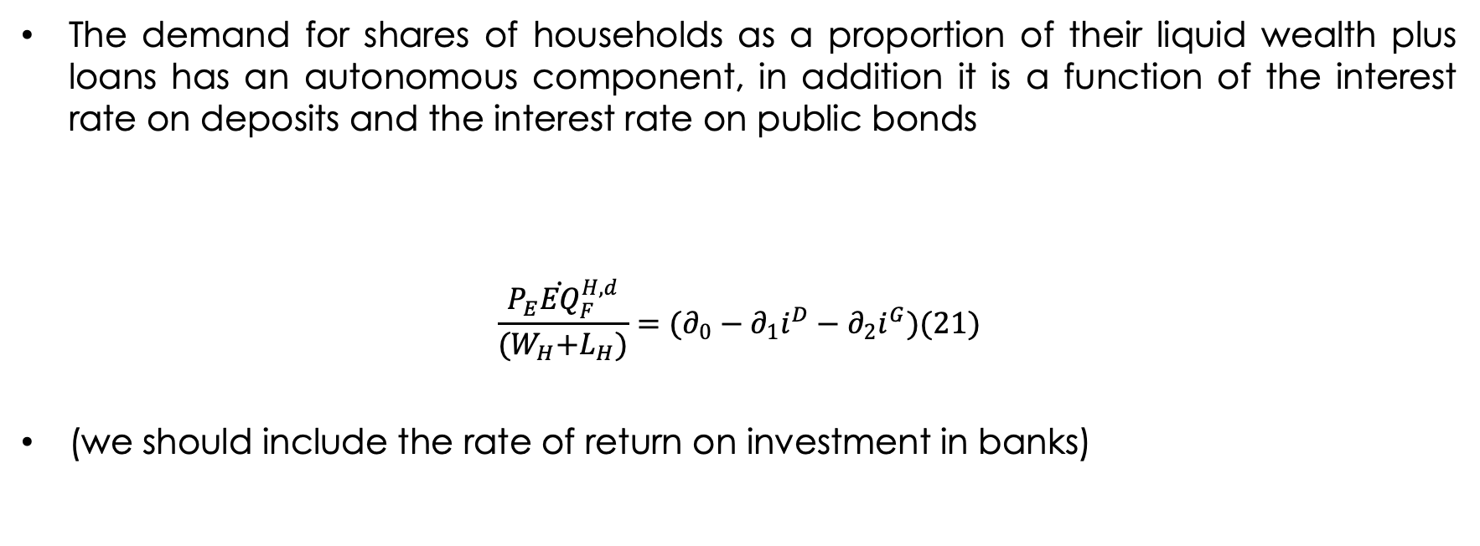
Equities and ownership structure
The demand for shares of households as a proportion of their liquid wealth plus loans has an autonomous component, in addition it is a function of the interest rate on deposits and the interest rate on public bonds
$$\frac{P_{E}{\dot{EQ}}_{F}^{H,d}}{{(W}_{H}+L_{H})}=(∂_{0}−∂_{1}i^{D}−∂_{2}i^{G})(21)$$
(we should include the rate of return on investment in banks)

Slide 14
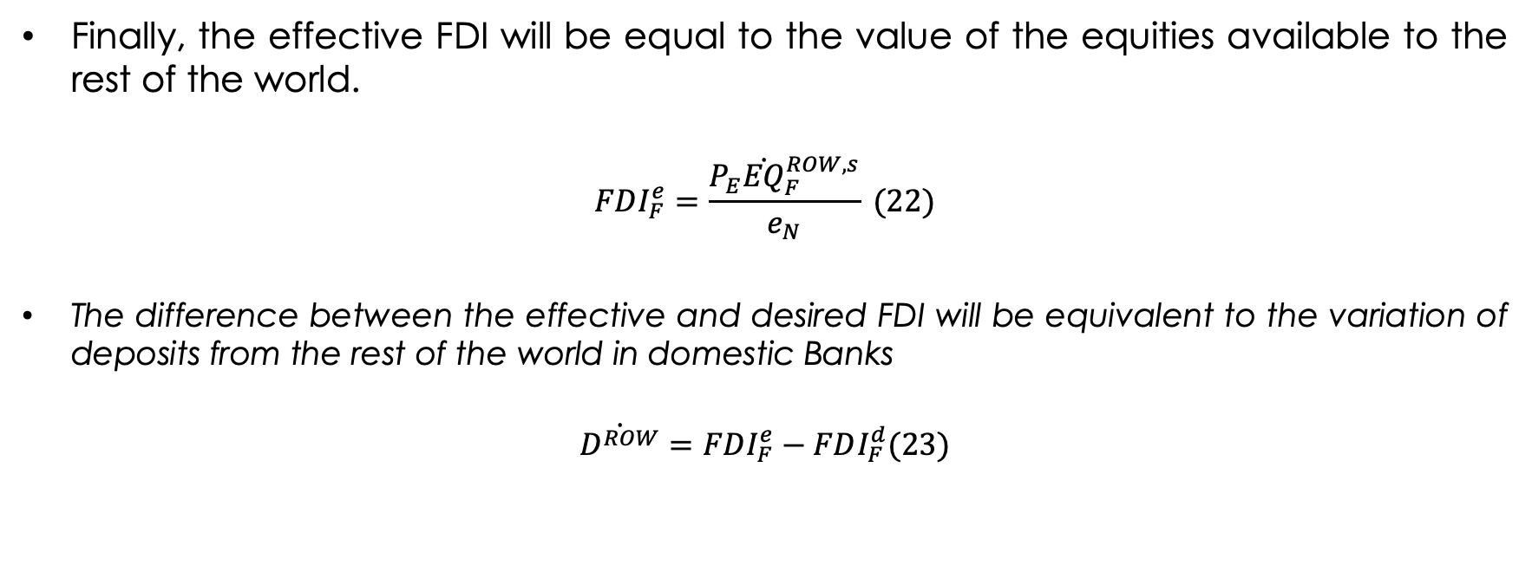
Equities and ownership structure
Finally, the effective FDI will be equal to the value of the equities available to the rest of the world.
$$FDI_{F}^{e}=\frac{{P_{E}\dot{EQ}}_{F}^{ROW, s}}{e_{N}} (22)$$
The difference between the effective and desired FDI will be equivalent to the variation of deposits from the rest of the world in domestic Banks
$$\dot{D^{ROW}}=FDI_{F}^{e}−FDI_{F}^{d}(23)$$

Slide 15
Outstanding issues
Distribution between Greenfield and non greenfield FDI aimed at the firm
Define the ownership structure of the banks, although we consider that it can be very similar to that of the firms.
Define the arbitration between FDI directed to firms and that directed to banks

Slide 17
References.
Bhaduri, Amit & Marglin, Stephen, (1990). "Unemployment and the Real Wage: The Economic Basis for Contesting Political Ideologies," Cambridge Journal of Economics, Oxford University Press, vol. 14(4), pages 375-393, December.
Caiani, Alessandro & Godin, Antoine & Caverzasi, Eugenio & Gallegati, Mauro & Kinsella, Stephen & Stiglitz, Joseph E., (2016). "Agent based-stock flow consistent macroeconomics: Towards a benchmark model," Journal of Economic Dynamics and Control, Elsevier, vol. 69(C), pages 375-408.
Dafermos, Yannis, 2012. "Liquidity preference, uncertainty, and recession in a stock-flow consistent model," Journal of Post Keynesian Economics, Taylor & Francis Journals, vol. 34(4), pages 749-776.
Passarella, M. (2019). "From abstract to concrete: some tips for developing an empirical stockâ€“flow consistent model," European Journal of Economics and Economic Policies: Intervention, Edward Elgar Publishing, vol. 16(1), pages 55-93, April.
Pedrosa, I ; Biancarelli(2015).”Surges in capital inflows and the macroeconomic dynamics of peripheral economies- a stock-flow consistent model”.
Till van Treeck, (2007). "A Synthetic, Stock-Flow Consistent Macroeconomic Model of Financialisation," IMK Working Paper 06-2007, IMK at the Hans Boeckler Foundation, Macroeconomic Policy Institute.
Valdecantos, S. (2016).”Estructura productiva y vulnerabilidad externa- un modelo estructuralista stock-flujo consistente”

